Slide 1
Exercises of Chapter 3

Slide 2
(1) What name is given to the following reaction?
galactose + glucose → lactose + water
D
A) hydrolysis
B) hydrogenation
C) glycolysis
D) dehydration

Slide 3
Animals store carbohydrates as ________.
B
A) cellulose
B) glycogen
C) starch
D) maltose

Slide 4
(3) Which of the following is lowest in unsaturated fats?
A
A) beef
B) salmon
C) corn oil
D) canola oil

Slide 5
Amino acids include a side group as well as ________.
A
A) a central carbon, a hydrogen atom, an amino group, and a carboxyl group
B) a central carbon, a hydrogen atom, a hydroxyl group, and a carbonyl group
C) a central nitrogen, a carbon atom, a hydroxyl group, and a carbonyl group
D) a central nitrogen, a carbon atom, an amino group, and a carbonyl group

Slide 6
(5) A DNA molecule has the sequence AGTTCAACT. The equivalent RNA molecule would have the sequence ________.
B
A) AGTTCAACT
B) AGUUCAACU
C) UGTTCUUCT
D) UGUUCUUCU

Slide 7
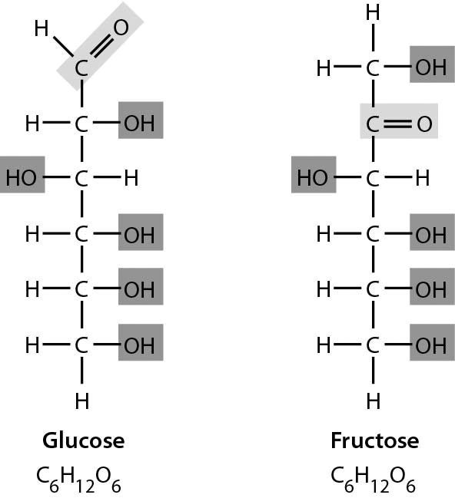
(6) Examine the two sugars in the following figure.
How do these two sugars compare?
C
A) Glucose has more hydrogen.
B) Glucose has more double bonds.
C) They have the same formula but different structures.
D) They are structurally identical in every way.

